Slide 1
Software Engineering CS20006
Lecture 3
Requirement Analysis : Case Studies

Slide 2
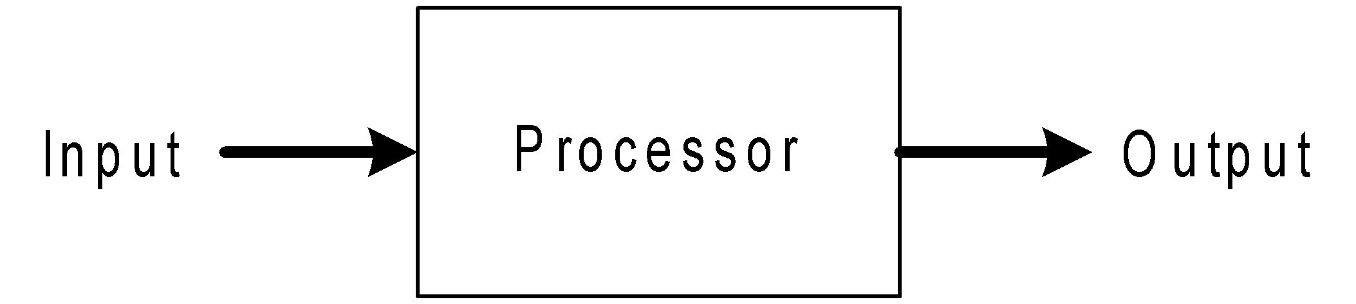
Definition of a System
System?
=

Slide 3
What is Software System?
An Software System is a combination of
Hardware
Software
Telecommunication networks (Internet)
Which people build and use to
Collect
Create
Distribute data
Typically in
Organizational setting

Slide 4
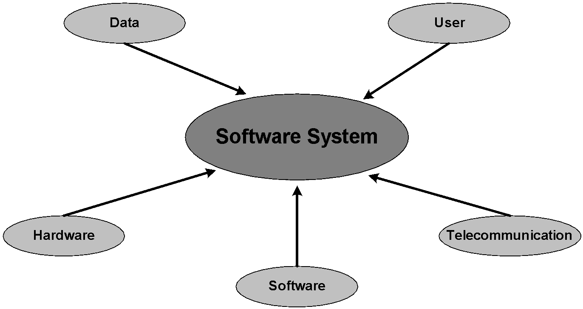
Components of a Software System

Slide 5
Example of Software Systems
5 Examples?

Slide 6
Example of Software Systems
Library Information System
Course Management System
Enterprise Resource Planning
On-line Business Transaction (e-Commerce)
Microsoft Office
www.iitkgp.ernet.in
MatLab

Slide 7
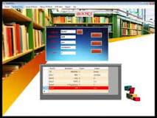
Example of Software Systems
Case Study
Library Information System

Slide 8
Components of a Software System
?

Slide 9
Case Study: Library Information System
Problem Description
Users point of view:
Three types of users are there
Borrowers (perform transactions with the system)
Library Management Personnel (who responsible for providing service, maintenance, administration, ... etc.). Further they can be divided into two types
Library Assistants (support to the Borrowers for their transactions )
Library Managers (responsible for overall maintenance and management of the library)
Suppliers (who supply books, response to quotations etc.)

Slide 10
Case Study: Library Information System
Problem Description
Functional point of view:
Privileged services for the Borrowers
Get registration
Membership renew
Search book
Renew book
Reserve book
Privileged services for the Library Assistants
Issue and renew book to a borrower
Return a book by a borrower
Validate new registration
Validate renew of membership
Delete a membership

Slide 11
Case Study: Library Information System
Problem Description
Functional point of view:
Privileged service for the Library Manager
Enter a New book
Remove a book
Billing System
Get membership fee
Get renewal fee
Get fine/recovery charge
Payment to a supplier
Status of books
Total number of books in the text book section
Total number of books in the reference section
Number of books lost etc.

Slide 12
Case Study: Library Information System
Problem Description
Functional point of view:
Privileged services for the Library Manager
Miscellaneous queries
Total number of books for a given subject
How many books for a given title?
How many books for a given author?
Total deposit on membership
Total earn on fine/recovery
Privileged services for the Suppliers
Books on demand
Authorization request
Response to quotation
Submit bill
Get payment etc.

Slide 13
Components of a Software System
?

Slide 14
Case Study: Library Information System
Problem Description
Information point of view:
List of books
List of borrowers
List of library personnel and their authorizations
List of all suppliers and supplies

Slide 15
Components of a Software System
?
?
?

Slide 16
Problems to Ponder
Identify the different components in the following systems
Microsoft Office
Cellular Phone

Slide 17
How we can specify a software system under development?

Slide 18
An example: SANYOG
Internet access to underdeveloped communities in India
In recent years, with the exponential growth of Information Technology (IT), Internet has spread almost in all applications. However, the Internet advantages are confined to the limited communities only in our country. The majority communities, who have some inherent limitations such as illiteracy, unfamiliarity with foreign languages, cyber ignorance, low-bandwidth communication links etc. are still unable to participate in the IT revolution. An IS can be planned to give a solution that transcend these barriers and bring Internet services to everyone.

Slide 19
ICT to Rural India
Title of the software system
SANYOG
An interface to Internet for people in India

Slide 20
Objectives of SANYOG
Support Internet access to backward communities in India in their mother languages.
Design and development of Indian languages (e.g., Hindi, Bengali, Telegu) compatible user interface (browser?).
Providing multi-modal interactions facilities for user-friendly interaction to Internet, so that people of varieties level of experience can enjoy the system.

Slide 21
Specification of SANYOG
System:
An integrated systems meeting all the objectives of the project.
Subsystems:
Browser interface compatible with Hindi
Browser interface compatible with Bengali
Voice enabled interface and information retrieval
Icon-based man-cyber interaction
Dialogue-based information access
E-mail based off-line Internet access

Slide 22
Type of SANYOG
Research, Development & Engineering (R, D & E) leading to production capability
Application oriented Research, Design and Development (R, D&D) having production potential
Basic R&D

Slide 23
Typical End User of SANYOG
Rural communities in the belt of Hindi, Bengali and Telegu languages
Other relevant applications in state and central government offices
Research communities

Slide 24
Technical Details of SANYOG
Urgency of the proposed system
Aim and Challenges
Solution
Architectural level
Work plan
Planning, Analysis, Design, Implementation and testing

Slide 25
Urgency of SANYOG
The spectacular growth in Internet, which becomes synonymous with the World Wide Web (WWW), makes a rapid advancement in Information and Communication Technology (ICT). However, the explosive growth of ICT and its many applications in education, science, services and other activities etc. are confined within a limited number of so called privileged people, who live in digital pockets. In fact, the rural people in our country are yet to be included in this ICT revolution. It is not so worth to mention that the overall growth of the country depends on the growth of the rural human resources in India. Further, the rural population is 76% of the overall population in India and with reference to the intellectuality they are also no way inferior compared to their urban counterparts. In order to diminish the imbalance it is therefore an urgent need to make an info-communications bridges between Rural India and the Internet. There are so many odds to achieve this like computer illiteracy, language barrier, low-bandwidth communication connectivity, inadequate training facilities etc. are some reasons. It therefore makes a challenge for us to extend it towards the underprivileged community in India. This issue need to be addressed and find a solution in ICT for Rural India. This system will be an indigenous effort to design and develop an integrated framework with which the Indian people in general and the rural people in particular will be able to share the WWW in their mother languages. Otherwise some digital revolution takes place, it is not expected to get any breakthrough in the existing telecommunication infrastructure in the present decade and anticipating this scenario a novel solution has been proposed to overcome the low-bandwidth communication limitation to access the Internet by rural mass.

Slide 26
Aim and Challenges in SANYOG
Currently Internet becomes synonymous with World Wide Web (WWW). The popularity of WWW is largely dependent on the search engines. Search engines are the access point of the huge information repository at the internet. The user interface of the existing search engines takes a query string as an input from the user. Based on the keywords present in the query string they search for relevant documents. This type of interface works fine for well literate people. But for illiterate people or those who has not enough proficiency and expertise to construct a good query strings cannot use this. The rural communities in India are a perfect example of this category of users. Hardly, they have the proficiency of constructing a good query strings in English to extract their information from WWW. These problems are compounded when novice users come into the consideration. These categories of computer illiterate users have a huge gulf between “search and information”. Another, limitations for rural users is having very slow rate of information access, because of the low-bandwidth connectivity to the Internet, which severally discourages them to be associated with the cyber world.
SANYOG is proposed to give a solution that transcend these barriers and bring Internet services to everyone in Rural India.

Slide 27
Blue Print of SANYOG
(An architectural level solution)

Slide 28
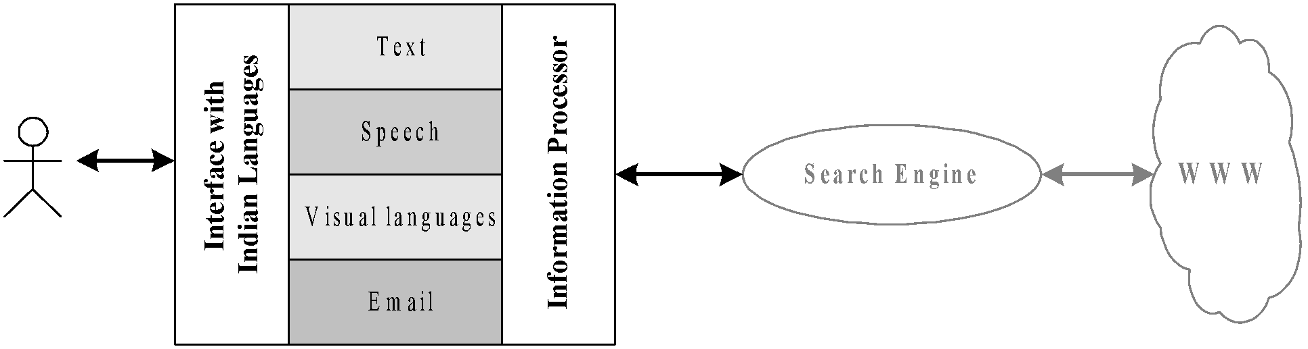
Basic Architecture of SANYOG

Slide 29
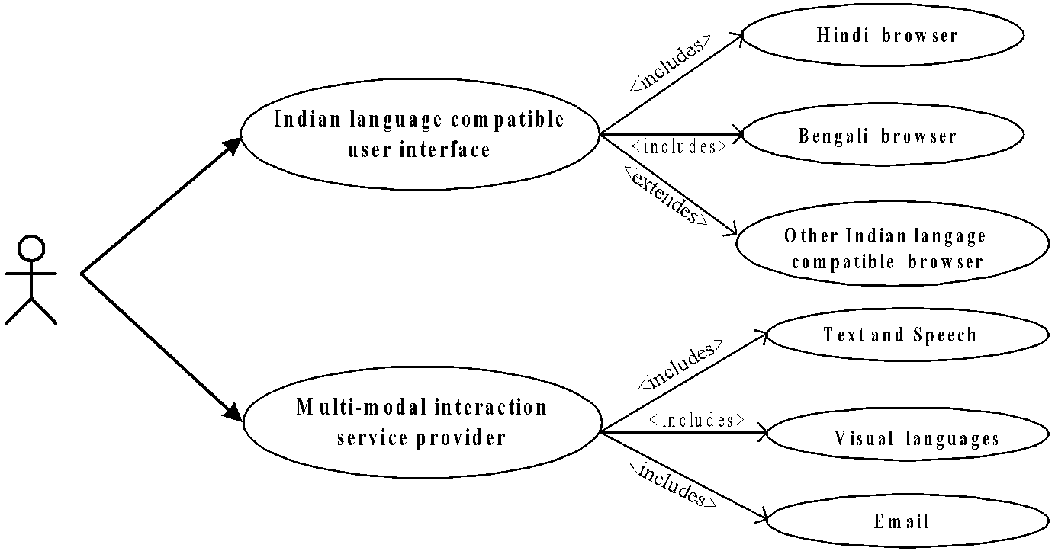
Use Case Diagram of SANYOG

Slide 30
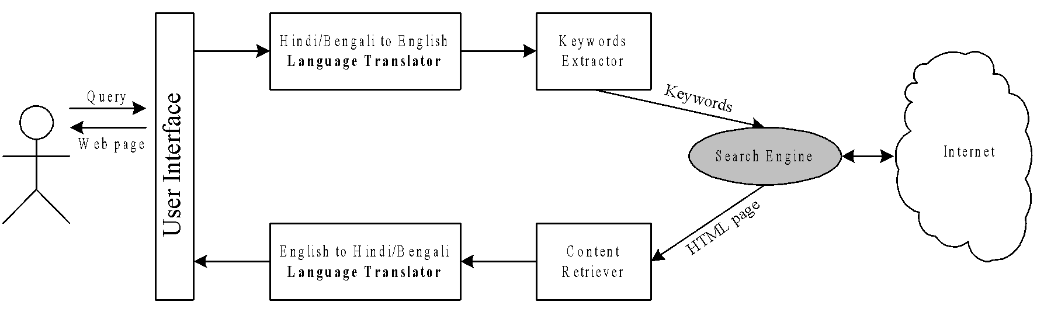
System View of SANYOG

Slide 31
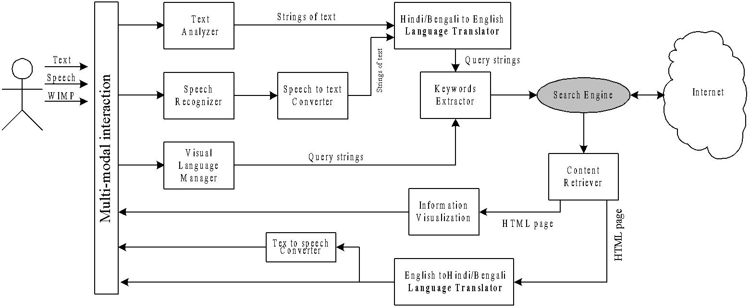
Architecture of the Multi-modal User Interface Component

Slide 32
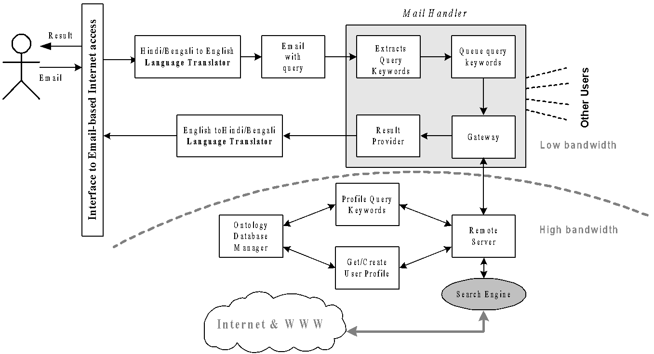
Architecture of the Component that Access Internet through Email

Slide 33
Work Plan
Duration of the project: 36X6 PM months
Year 1
Browser interface compatible with Hindi
Browser interface compatible with Bengali
Year 2
Voice enabled interface and information retrieval
Icon-based man-cyber interaction
Dialogue-based information access
Year 3
E-mail based off-line Internet access

Slide 34
Requirements
Hardware?
Software??
Others ???

Slide 35
Towards the deliverables……
Planning?
Analysis?
Design?
Implementation?
Testing?
Deployment?

Slide 36
Problems to Ponder
Define and understand the term Software Systems
Explain the technology, people, and organizational components in Software Systems
Describe the various types of Software Systems
Merits and demerits of Software Systems

